Slide 1
Navigating Uncertainty: Strategic Planning for your Job Search
Monday Speaker
Feb 6th, 2017
Notes:
Introduce myself
Welcome everyone, see if there are any veterans in the room.
Ask everyone to be present for the next hour or so
-Please place any outside thoughts on the shelf-you can pick them up on the way out.
I am excited to be hear, Let me tat

Slide 2
The Neal Henderson Story
Joined the US Marine Corps-May 1979
Discharged from the Marine Corps Nov 1985 with an RE-3P
Enlisted in the Navy Reserves Aug 1986
Retired from the Nay March 2008
Graduated UMUC 2010: BS in Human Resources
Graduated George Mason 2012: MS ODKM
Front Row Performance Coaching 2013
ICI Services 2015

Slide 3
Since I have been in High School…
With the exception of joining the Marine Corps in 1979,
My network has always referred into my next position, I have not been successful applying to a “cold” job announcement
Notes:
Let that sink in for a minute

Slide 4
Today’s Objectives
Apply Strategic Planning to your Job Search
What is the difference between a Career Position and a JOB.
What is Strategic and Tactic Planning and What are the differences
How to apply Strategic and Tactical planning to my job search

Slide 5
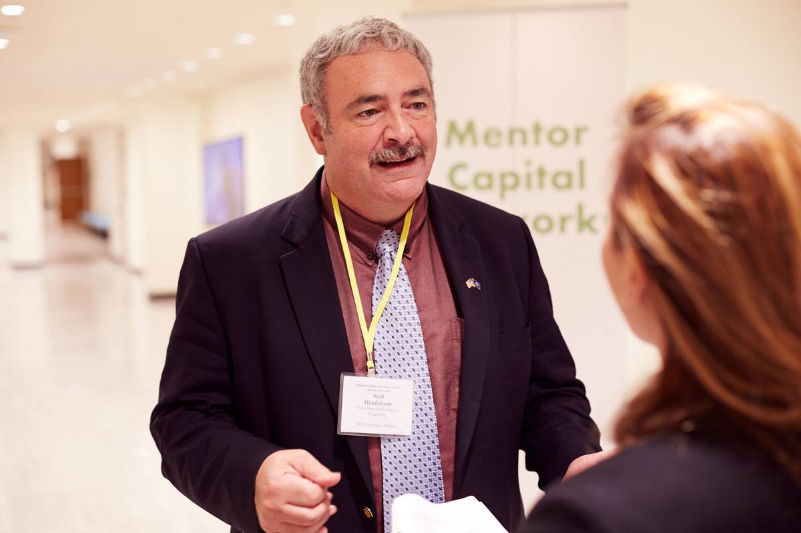
Let’s get to know each other a bit
Please introduce yourself
Name
Career Field
What do you do when nobody is paying you

Slide 6
Any Uncertainty out there?
Notes:
New Administration
New Policies
New Industries

Slide 7
Any Stress?
Is there a gap between what you want to do, and what you think you can do
Are you reaction to challenging situations (A perceived threat)
Any feelings of lack of control, inability to handle your current situation
Notes:
Stress can be defined in many ways.
-A gap between what you want to do, and what you think you can do
-A reaction to challenging situations (A perceived threat)
-Lack of control, inability to handle your current situation
The response to bodies way to rise to a challenge.
Stress Response:
In the way back-flight or flight response-making us more alert etc.
Releases harmonies into the body
-Adrenaline, (Flight or Fight Hormone) causes your heart rate to increase, gives a surge of energy, and focuses your energy
-Norepinephrine: Similar to Adrenaline, helps shift blood flow way from less crucial areas, such as your skin to more essential areas such as your muscles
-Cortisol (Stress Hormone) maintains fluid balance and blood pressure, regulates some body functions which are not critical such as digestion, growth, reproductive drive, and immunity.
With elevated stress hormones comes physical issues-high blood pressure, obesity, etc.
-Dopamine, long periods with high stress reduces the amount of dopamine your brian will produce, which means you will find less pleasure in the things that you find pleasurable.

Slide 8
The Impact of Stress
Too much stress
Tunnel Vision
Reduced confidence
Reduced risk taking
Health Challenges
Mental Health Challenges
Notes:
Stress can be defined in many ways.
-A gap between what you want to do, and what you think you can do
-A reaction to challenging situations (A perceived threat)
-Lack of control, inability to handle your current situation
The response to bodies way to rise to a challenge.
Stress Response:
In the way back-flight or flight response-making us more alert etc.
Releases harmonies into the body
-Adrenaline, (Flight or Fight Hormone) causes your heart rate to increase, gives a surge of energy, and focuses your energy
-Norepinephrine: Similar to Adrenaline, helps shift blood flow way from less crucial areas, such as your skin to more essential areas such as your muscles
-Cortisol (Stress Hormone) maintains fluid balance and blood pressure, regulates some body functions which are not critical such as digestion, growth, reproductive drive, and immunity.
With elevated stress hormones comes physical issues-high blood pressure, obesity, etc.
-Dopamine, long periods with high stress reduces the amount of dopamine your brian will produce, which means you will find less pleasure in the things that you find pleasurable.

Slide 9
The Impact of Stress
Too much stress
Tunnel Vision
Reduced confidence
Reduced risk taking
Health Challenges
Mental Health Challenges
A Positive level of Stress
Enjoyment
Innovation
Achievements
Notes:
Stress can be defined in many ways.
-A gap between what you want to do, and what you think you can do
-A reaction to challenging situations (A perceived threat)
-Lack of control, inability to handle your current situation
The response to bodies way to rise to a challenge.
Stress Response:
In the way back-flight or flight response-making us more alert etc.
Releases harmonies into the body
-Adrenaline, (Flight or Fight Hormone) causes your heart rate to increase, gives a surge of energy, and focuses your energy
-Norepinephrine: Similar to Adrenaline, helps shift blood flow way from less crucial areas, such as your skin to more essential areas such as your muscles
-Cortisol (Stress Hormone) maintains fluid balance and blood pressure, regulates some body functions which are not critical such as digestion, growth, reproductive drive, and immunity.
With elevated stress hormones comes physical issues-high blood pressure, obesity, etc.
-Dopamine, long periods with high stress reduces the amount of dopamine your brian will produce, which means you will find less pleasure in the things that you find pleasurable.

Slide 10
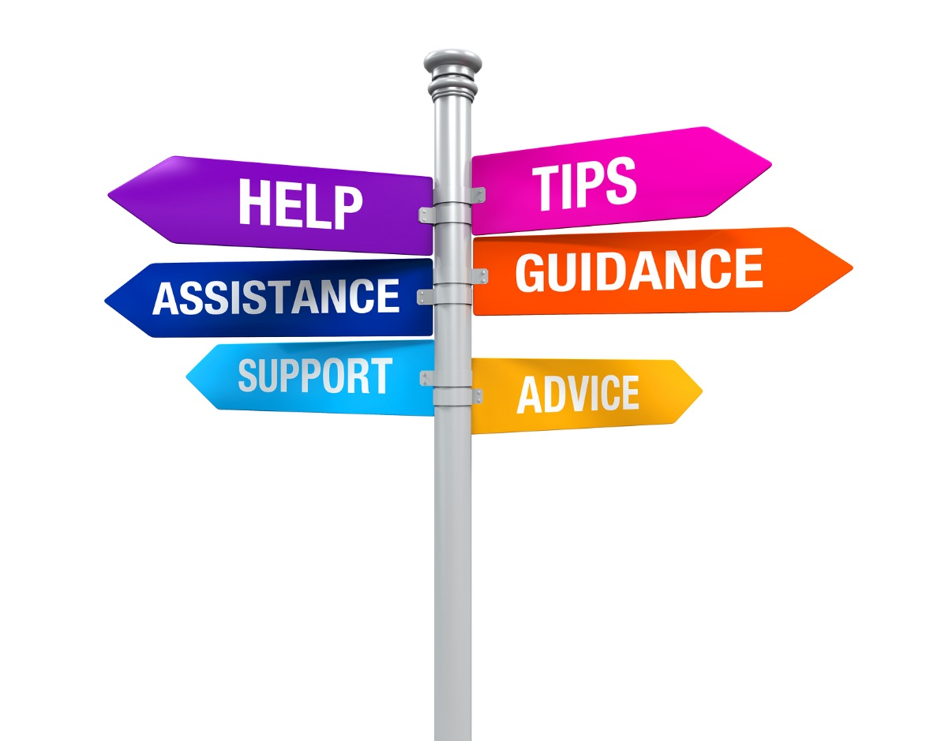
Take time to reflect
Clear your mind
Take care of yourselves
Be Physically active
Be Nutritionally sound
Take Control of your Career
Take Control of your schedule
Be Intentional Be Present
Notes:
Get Physical
Exercise 3 times a week
Get out of your chair and walk around
Stretch throughout the day
Nutritionally Sound
Monitor your consumption
Monitor your Alcohol and Caffeine Consumption Drink plenty of water
Benefits
Increased confidence
Increased Emotional stability- resilience
Improves your appearance, you look healthier
More command presence
Increased mental aglity

Slide 11
Benefits
Increased confidence
Increased resilience & Emotional Stability
Improves your appearance, you look healthier
More command presence
Be Intentional Be Present
Notes:
Get Physical
Exercise 3 times a week
Get out of your chair and walk around
Stretch throughout the day
Nutritionally Sound
Monitor your consumption
Monitor your Alcohol and Caffeine Consumption Drink plenty of water
Benefits
Increased confidence
Increased Emotional stability- resilience
Improves your appearance, you look healthier
More command presence
Increased mental aglity

Slide 12
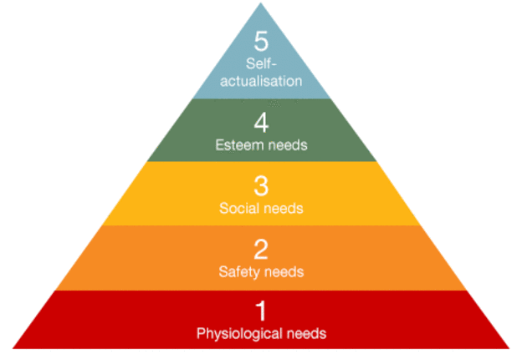
Career vs JOB
Career Position
You are not “working’
You are challenged
Not enough time in the day
JOB
It pays the bills
Watch the clock
Notes:
Self-actualization – includes morality, creativity, problem solving, etc.
Esteem – includes confidence, self-esteem, achievement, respect, etc.
Belongingness – includes love, friendship, intimacy, family, etc.
Safety – includes security of environment, employment, resources, health, property, etc.
Physiological – includes air, food, water, sex, sleep, other factors towards homeostasis, etc.

Slide 13
Strategic Planning:
A Road map to an organization’s Future
Generally a 3-5 year horizon
Sets Organizational Direction
Defines Strategies
Sets priorities
Defines resources and Control measures
Tactical Planning:
A short term planning
1 year of less
Specific short term actions
Implements Strategic Planning action plans
Notes:
Strategic Planning
-Your strategic plan will be a much shorter horizon
-Need to create one for your career as well as for your job search
Serenity Prayer
Grant me
The Serenity to accept the things I cannot change
The Courage to change the things I can
And the wisdom to know the difference
In short Strategic Planning enables us to operationalize the Serenity Prayer

Slide 14
Strategic Planning Process
Gathering Information
Formulating Ideas
Formulating Action

Slide 15
Vision-AKA Ideal Position
Purpose/Mission
Your Strategic Plan
Values
Goals
Objectives
Initiatives

Slide 16
Gathering Information

Slide 17
What is my ideal Position? What am I searching for?
Vision
Notes:
Describe, in great details, your ideal position
Commute, how do I want to travel to work, cube or office
Flexible work schedule, telework, schedule
Type of work, individual contributor, collaborator
Then sort out your answers into three buckets and prioritize within the buckets

Slide 18
What is your Purpose and Values
What make you feel the most successful
What differentiates you from others
Notes:
10 Stories-Give my example
-Short paragraphs, Situation, Task, Achievement, Your results and contributions and most importantly HOW DID YOU FEEL
-reflect-where are you most successful, where do you feel the most engaged, most enthusiastic
-Values- define 3-5 principle values. Email 10-15 people, family, friends, colleagues, Direct Reports and supervisors. Ask them to provide 3 words describing you. When you get them back, sort and categorize them. You will now have great adjectives for describing you, you will see what values you demonstrate

Slide 19
What are my
Skills I am good at AKA Strengths
Skills I am not good at AKA Weaknesses
Likes and Dislikes
Good at
Strengths
Weakness
Like to do
Do not forget the skills you use while doing the things you do without pay
Notes:
Identify your
What you are interested in and good at, AKA Strengths
What you are interested, but not good at; could improve with practice/education AKA Talents
What you are good at but do not like to do
What you are not good at and you do not want to do

Slide 20
What are my
Opportunities
Threats
Notes:
So What am I looking for?

Slide 21
Formulating Ideas

Slide 22
Goals and Objectives
Goals: A desired result or possible outcome
Are broad and general intentions
Tend to be intangible or abstract
Objectives:
Are specific and narrow
Precise and measureable

Slide 23
Goals and Objectives
Goals:
Develop an understanding for cybersecurity careers by May 2017
Identify the certification requirements for the Program Management Professional (PMP) credential By June 2017
Identify high potential networking opportunities by April 2017
Objectives:
Find 5 Cybersecurity job descriptions by April 2017
Conduct 5 informational interviews with Cybersecurity professionals by April 2017
Conduct a gap analysis on my credentials, then create a plan to obtain the necessary education to earn my PMP by May 2017

Slide 24
Formulating Action

Slide 25
Finalize your Strategic Plan
Prioritize your Goals and Objectives
Identify the resources needed
Define the tasks required to achieve your Objectives
Define the metrics

Slide 26
Tactical Planning AKA Plan your work; Work your Plan
Year in Site
Quarter in Site
Week in Site
Day in Site
Learn to say NO
Notes:
Tools needed
-Your prioritized Goals/Objectives/Tasks from your Strategic Plan
-A Calendar

Slide 28
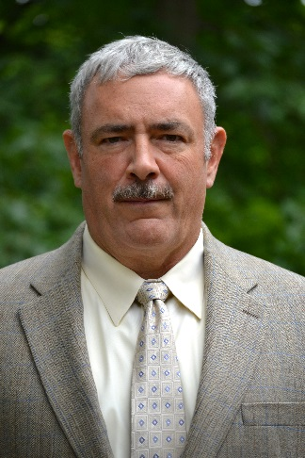
Front Row Performance Coaching
Neal Henderson
Front Row
Performance Coaching
Annandale, VA
Neal@frontrowresults.com
30+ yrs in OD, Org. Change Management & Performance Improvement as a consultant, trainer and coach
Extensive experience using a data-driven approach to create high performance, engagement and workplace excellence
A Service-disabled Veteran Owned Small Business
Connect with Us
www.linkedin.com/in/njhenderson
FrontRowResults
www.FrontRowResults.com
(240) 606-5764 or email info@frontrowresults.com

